Slide 1


Bird Strikes in Aviation
Team 207
Jacqueline Chiu, Harul Murugan Ramamoorthy Soppana, Koushika Ravikumar, Pranay Shah

Slide 2
Business Problem
Bird strikes - collisions between aircraft and wildlife - pose serious risks, particularly during low-altitude flight phases like takeoff and landing, where they can damage jets and even cause fatal accidents.
Objective: Enhance safety, minimize costs, ensure compliance, and deliver reliable travel experiences.

Slide 3
Methodology Models & Goals
Predictive Analysis:
  Goal: Predict the likelihood of a bird strike, the occurrence and severity of damage, and the financial costs associated.
  Models: Logistic Regression, Decision Tree
Cost Analysis:
  Goal: Analyze the financial impact of bird strikes and identify the factors that escalate costs.
  Models: ADA Boosting, Random Forest

Slide 4
Business Importance
Safety:
Bird strikes pose significant safety risks to passengers, crew, and aircraft, especially during critical flight phases like takeoff and landing.
Economic Impact:
Bird strikes can lead to costly repairs, delays, and operational disruptions, impacting airlines’ financial stability.
Operational Efficiency:
By identifying risk factors, airlines and regulators can develop proactive strategies to reduce bird strikes, enhancing operational efficiency.

Slide 5
Key Stakeholders
Airlines and Operators: To minimize costs and enhance safety.
Regulatory Authorities (FAA): To enforce safety protocols and evaluate policies.
Airport Authorities: To manage local wildlife (birds) and reduce risks and around runways.
Aircraft Manufacturers: To improvise designs to withstand wildlife encounters.
Passengers and Crew: For whom safety is paramount.

Slide 6
Data Overview
Total Number of Records (Incidents) = 25,429
Data period: 2000-2011 provided by the FAA
Target Variable: ‘damage_encoded’
Predictors for Predictive Analysis:
  ‘Altitude’, ‘FlightPhase’, ‘WildlifeSpecies’, “PilotWarned’
Predictors for Cost Analysis:
  ‘Cost’, ‘NumberStruckActual’, ‘AircraftType’, ‘Engines’

Slide 7
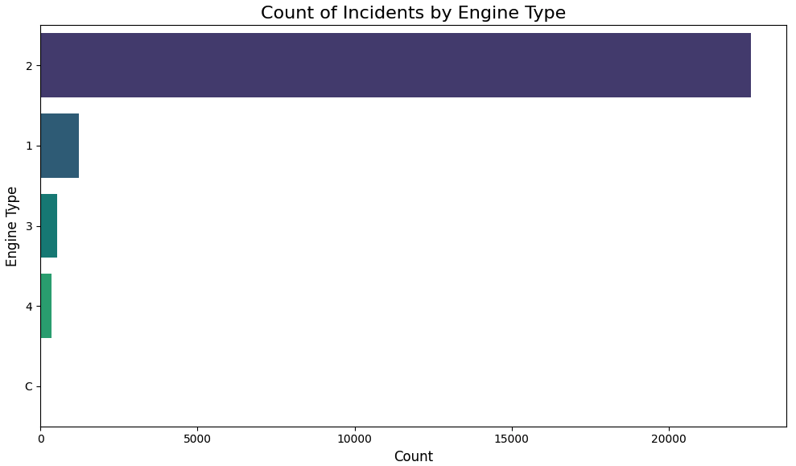
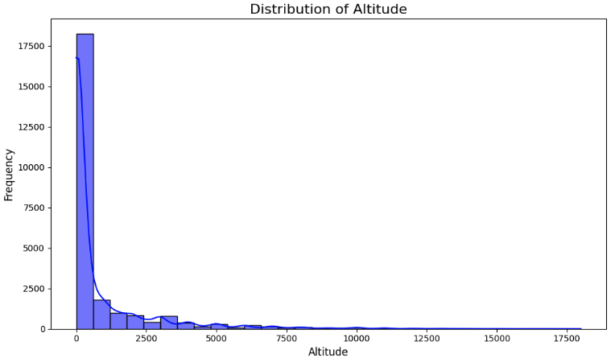
Initial Data Understanding
Engine Type 2 has the most incidents reported, exceeding 20,000.
Bin [0,625] has the highest frequency of Altitude incidents.

Slide 8
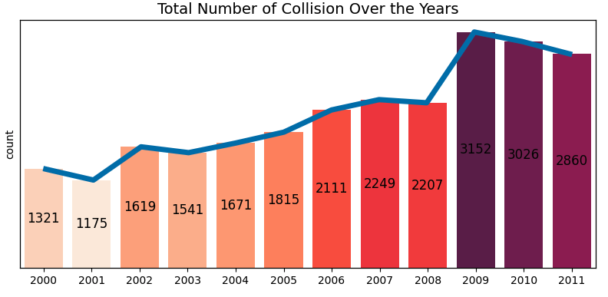
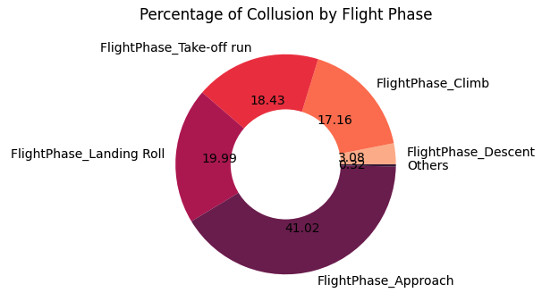
Initial Data Understanding
The total number of collisions appeared to gradually increase each year starting in 2003, and sees a significant increase in 2009 followed. This is followed by a slight decrease in 2010 and 2011.
The ‘approach’ Flight Phase contributes to 41.02% of collisions, making it the riskiest flight phase.

Slide 9
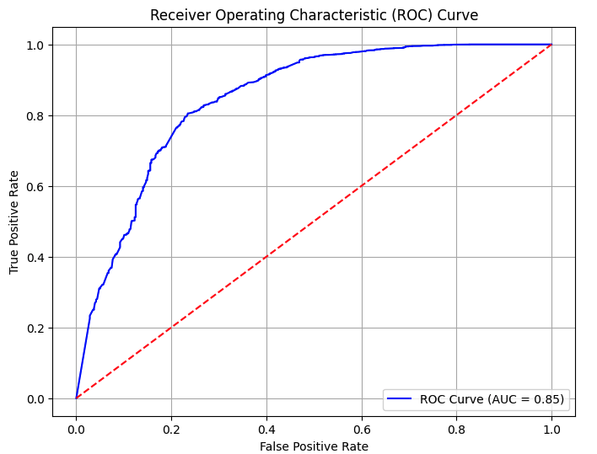
Predictive Analysis:
Logistic Regression

Slide 10
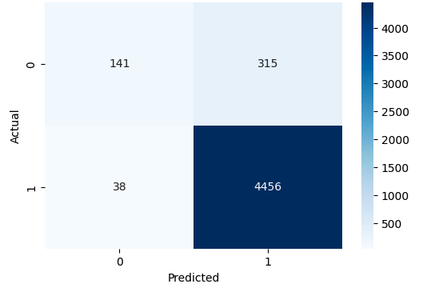
Predictive Analysis:
Logistic Regression Results
Accuracy: 0.93
Precision: 0.92
Recall: 0.93
F1 Score: 0.91

Slide 11
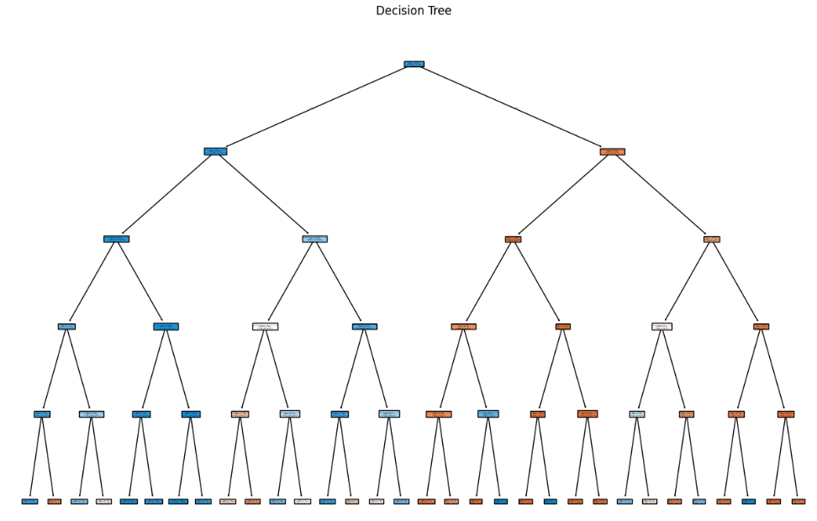
Predictive Analysis:
Decision Tree

Slide 12
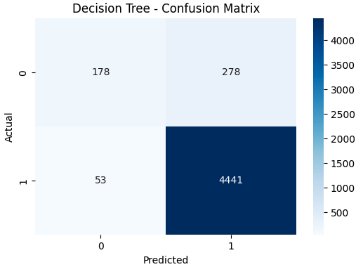
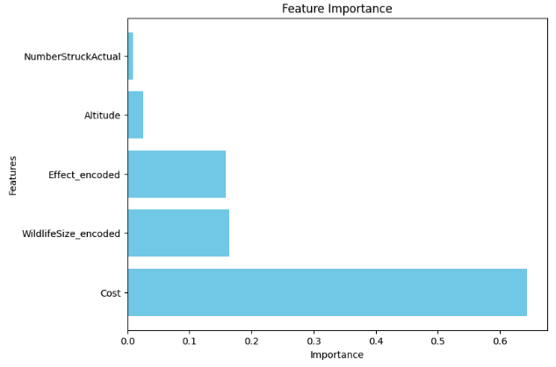
Predictive Analysis:
Decision Tree Results
Accuracy: 0.93 ; Precision: 0.93 ; Recall: 0.93 ; F1 Score: 0.92

Slide 13
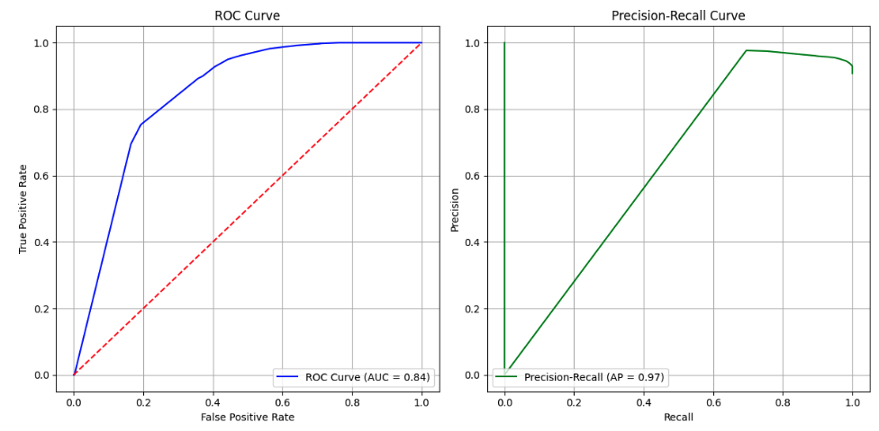
Predictive Analysis:
Decision Tree Results

Slide 14
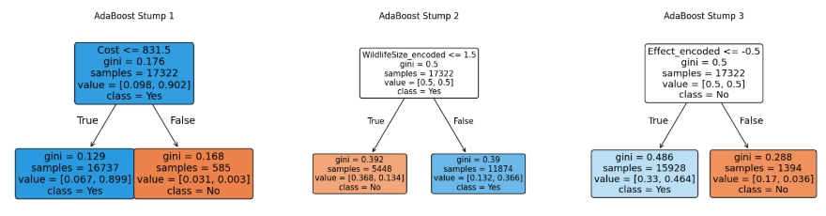
Cost Analysis:
ADA Boosting

Slide 15
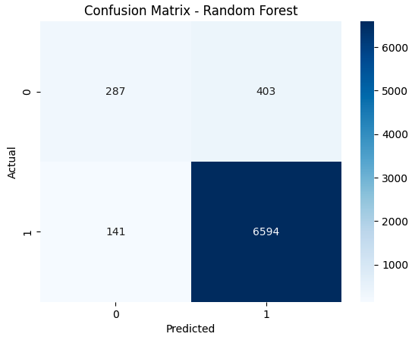
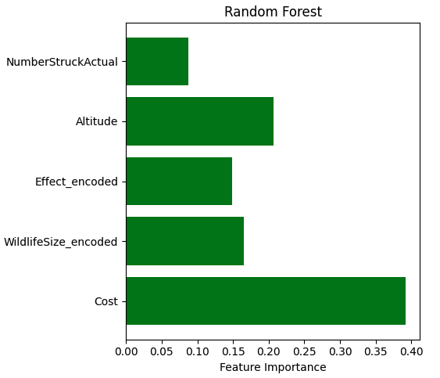
Cost Analysis:
Random Forest Results
Accuracy: 0.93 ; Precision: 0.94 ; Recall: 0.98 ; F1 Score: 0.96

Slide 16
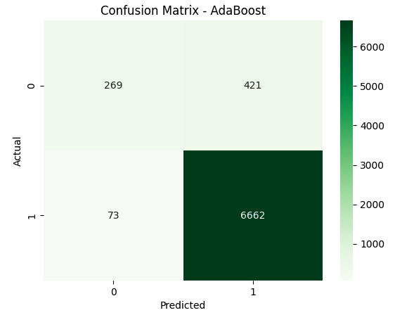
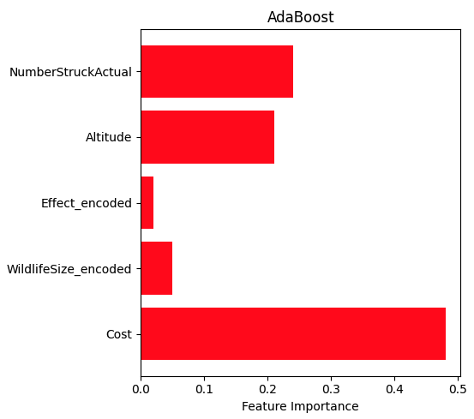
Cost Analysis:
ADA Boosting Results
Accuracy: 0.93 ; Precision: 0.94 ; Recall: 0.99 ; F1 Score: 0.96

Slide 17
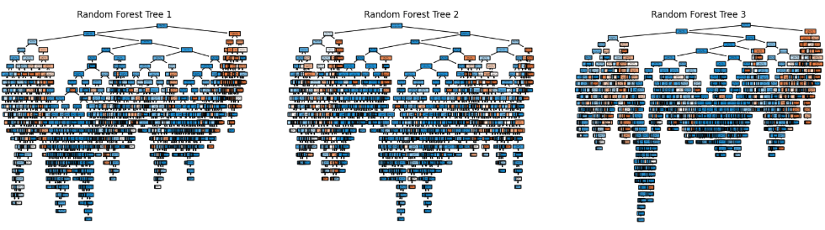
Cost Analysis:
Random Forest

Slide 18
Conclusions
Safety Risk Assessment:
The "approach" flight phase is the riskiest, accounting for over 41% of bird strike incidents. This highlights the need for targeted mitigation efforts during this phase.
Annual Trends:
Bird strike incidents have increased since 2003, peaking in 2009. This trend underscores a growing need for proactive measures as flight volumes and urban encroachment near airports rise.
Cost Analysis Insights:
Models such as ADA Boosting and Random Forest were effective in assessing financial impacts, with recall values nearing 99%, suggesting strong capabilities in identifying costly incidents.

Slide 19
Key Takeaways
Operational Improvements:
Airlines can use predictive insights to enhance pre-flight assessments and adjust operational procedures, focusing on high-risk flight phases like landing approaches.
Economic Benefits:Proactively addressing bird strike risks can significantly reduce repair costs, minimize flight delays, and improve overall operational efficiency.
Technological Enhancements:Aircraft manufacturers can prioritize research into engine designs and structural reinforcements to better withstand wildlife encounters.

Slide 20
Thank you!
Q & A

